Slide 1

Los Angeles Crime Data Analysis
Presented by: Radwa Mohamed

Slide 2
Table of contents
01.
Introduction
02.
Exploratory Data Analysis
03.
Insightes
04.
Conclusions

Slide 3
01.
Introduction

Slide 4
Introduction
This Analysis is Based on Los Angeles crime data from 2010 – 2025. we will be focusing on extracting crime patterns and meaningful insights.

Slide 5




Data Analysis project stages
Data Exploration
Feature Engineering
Data Understanding
Data
Cleaning

Slide 6

Exploratory Data Analysis
02.

Slide 7





Exploratory Data Analysis
Choosing only the meaningful columns to extract meaningful insights with crimes.
Columns used are:
Age
Gender
Ethnecity
Date & Time
Location

Slide 8
Insightes
03.

Slide 9

Insightes
A significant number of victims fall within the 35 to 54 age range.
For most of Crime types the same age group are the most victims.
Females are Most Victims for Domestic Violence, Violence and Sexual Assault
Males are more in cases of Burglary and General Theft
Burglary theft from vehicle dominates at night and evening, while Other Theft peaks in the afternoon. Violent crimes such as Simple Assault and Robbery occur most frequently during night and evening hours.

Slide 10

Insightes
LA Population Breakdown:
Hispanic or Latino (any race): 47.2%
Non-Hispanic White: 28.3%
Black or African American: 8.5%
Asian: 12.0%
Native American: 1.2%
Pacific Islander: 0.1%
From the mentioned population it make sense that Latino are the most victims in LA.

Slide 11

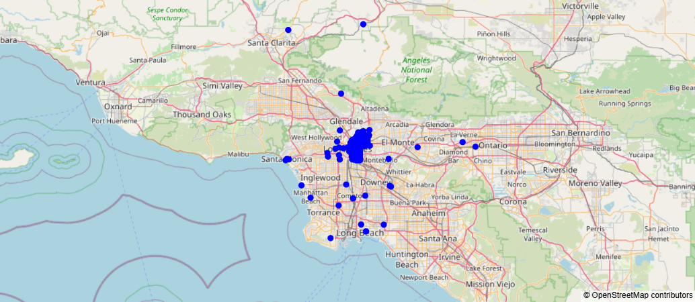
Insightes
Hollenbeck is the safest area according the number of crimes while 77th Street is the most dangerous Area.

Slide 12
Conclusion
Some Crimes are happened more for female and other more to male, there is no targeted ethnicity since Latinos are half of LA population, they are the most victims.

Slide 13
Thanks!
Do you have any questions?

